Slide 1
Final Presentation of Bachelor Thesis: Design and Implementation of a Privacy Assessment Framework for Synthetic Data Generation
By Karoline Siarsky
Supervised by: Weijie Niu, Dr. Alberto Huertas Celdran
Date: 21.10.2024
Notes:
Welcome to my final presentation about my bachelor thesis regarding the topic “Design and Implementation of a Privacy Assessment Framework for Synthetic Data Generation.
Synthetic data has become an important part of privacy-preserving technologies, but is it truly privacy preserving? This is the question that lead us to developing a framework that assesses both the privacy and utility of synthetic data.

Slide 2
Overview
Introduction & Background
Framework Design
Conclusion
Implementation
Evaluation
Related Work
Notes:
We will quickly have a look at the introduction and background,
then we will have a look at the related work.
After that, we will show you the design of our framework and
how we have implemented it.
And at the end, we will go into the evaluation and the conclusion of this thesis.

Slide 3
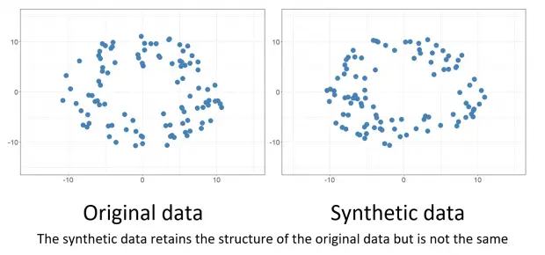
Introduction & Motivation
Why Synthetic Data?
Data Privacy Challenges (GDPR, data scarcity)
Synthetic Data as a privacy solution – Is it enough?
Data Scarcity: Certain domains face challenges in obtaining sufficient high-quality data due to limited availability and incomplete information.
Source picture: https://www.labellerr.com/blog/synthetic-data-vs-real-data-which-is-a-better-option-for-your-projects-2/
Notes:
So, with the introduction of regulations like GDPR, the General Data Protection Regulation, data privacy is more critical than ever. Synthetic data has been proposed as a solution that can help protect privacy by generating fake data.
Synthetic data plays an important role in sectors such as healthcare, finance, and social sciences.
It allows researchers to perform analysis, share information, and develop algorithms without the ethical and legal challenges of using real personal data.
It can also help to extend datasets, especially when obtaining large, high-quality real datasets is challenging.
However, as the use of synthetic data continues to grow, so do the associated privacy risks. So the question is, if synthetic data really is 100% privacy-preserving?

Slide 4
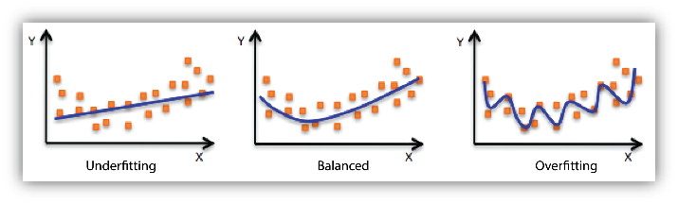
Example of Synthetic Data Risks
Risk of Overfitting in generative models
Example: Too similar distributions exposing sensitive information
Risk of Underfitting
Example: not able to learn distribution but simply copying real data records
→ Privacy and utility assessment framework
Source picture: https://docs.aws.amazon.com/machine-learning/latest/dg/model-fit-underfitting-vs-overfitting.html
Notes:
Here’s a small example. imagine a synthetic data generation model that overfits the data. Essentially, if the synthetic data too closely mimics the original data, it fails to protect the individuals' privacy, as the synthetic records could reveal sensitive information.
Also underfitted models that do not fully capture the data distribution and are oversimplified can expose sensitive patterns as such models might simply copy real data records.
Therefore, it is necessary not to assume by default that synthetic data is safe.
That leads us to the motivation of our work.
What we propose is a comprehensive framework that assesses the privacy and utility of synthetic data.
We did not invent the metrics or synthesizers included in the framework ourselves, but we designed a python framework that integrates existing methods to provide an evaluation of synthetic data

Slide 5
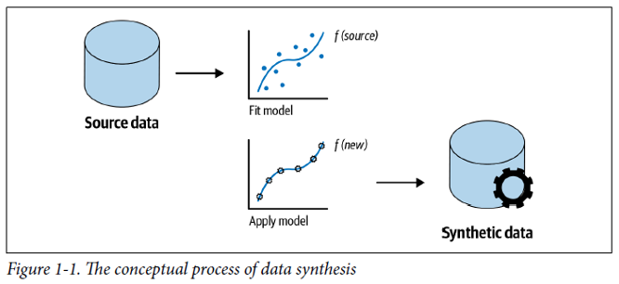
Background
What is synthetic data?
Generative models used: GANs, VAEs, etc.
Importance in privacy-preserving systems
Utility metrics vs. privacy metrics
→ Learn the probability distribution of the dataset and draw samples from it
Source Picture: https://www.tnpconsultants.com/en/all-you-need-to-know-about-synthetic-data/
Notes:
Synthetic data is essentially artificial data generated to replicate the statistical properties of real data, without being directly collected from actual events or individuals.
Commonly used methods to generate synthetic data include Generative Adversarial Networks (GANs) and Variational Autoencoders (VAEs).
Although synthetic data generation can be useful in various applications and, in theory, offers a solution to privacy issues by creating data that mirrors the original without directly copying it.
However, models often face a trade-off between utility (how useful the data is) and privacy (how protected the original data is).
The utility of synthetic data is essential for its effectiveness in training machine learning models and for other analytical purposes. If the data is too distorted to ensure privacy, its utility can significantly be reduced, which could make the data useless. On the other hand, if synthetic data is too similar to the original it might expose sensitive information.
((GANs consist of two neural networks—a generator and a discriminator—that compete against each other. The generator creates synthetic data, while the discriminator evaluates it, providing feedback that allows the generator to improve its outputs. This adversarial training enables the generation of high-quality data that closely resembles real data.
VAEs, on the other hand, rely on an encoder-decoder architecture. The encoder maps the input data to a latent space, from which the decoder generates new data by sampling
from it. VAEs incorporate probabilistic elements through Gaussian distributions, which enable the generation of new data by sampling the latent space and decoding it.
))

Slide 6
Related Work
Key Papers:
Health-GAN: Introduces NNAA metric.
Synthetic Data Risks: Highlights privacy concerns like MIAs.
DiSCO and repU: Privacy metrics for synthetic data.
GDPR-Based Metrics: Singling Out, Linkability, Inference risks.
Research Gap: Lack of a comprehensive framework combining different metrics.
Our Solution: Design and implement a framework to assess privacy and utility preservation in synthetic data.
Notes:
Before going into the framework design, we explore the related work on synthetic data generation and its evaluation.
The field is continuously growing due to increasing concerns about data sharing privacy.
Several papers have contributed to this field, For instance, Health-GAN introduces the Nearest Neighbor Adversarial Accuracy (NNAA) metric,
which focuses on maintaining data utility while ensuring privacy, particularly in healthcare datasets. Other research highlights the inherent privacy risks of synthetic data,
emphasizing the need for thorough evaluation tools to address issues like membership inference attacks (MIAs) and other inference-based attacks.
Some other studies propose metrics for evaluating synthetic data privacy, such as DiSCO (Disclosive in Synthetic Correct Original) and Replicated Uniques (repU). These metrics help quantify how much
sensitive information from the original dataset is retained in the synthetic data and measure the replication of unique data points. Similarly, other research employs GDPR-based metrics to assess Singling Out, Linkability, and Inference risks, which are important indicators of effective anonymization.
Despite these advancements, there remains a significant research gap in the field: the lack of a comprehensive framework that integrates various metrics from these
papers to provide an evaluation of synthetic data. Many studies evaluating synthetic data tend to focus on only a limited set of metrics, such as only the DCR or NNDR, but still
the issue of balancing privacy and utility in synthetic data generation is complex.
Our work aims to bridge this gap by designing and implementing a Python-based framework that combines different privacy and utility metrics.

Slide 7
Framework Design/ Methodology
Notes:
That leads us to our framework design.
Here on this slide, you can see the visualization which depicts all components of our framework.
So first, synthetic data can be created from the original datasets using different synthesizers, such as CTGAN, the gaussian mixture model or simply the random model which randomly samples from the original dataset.
Once the synthetic data is generated, the user gets to assess the data based on utility and privacy metrics,

Slide 8
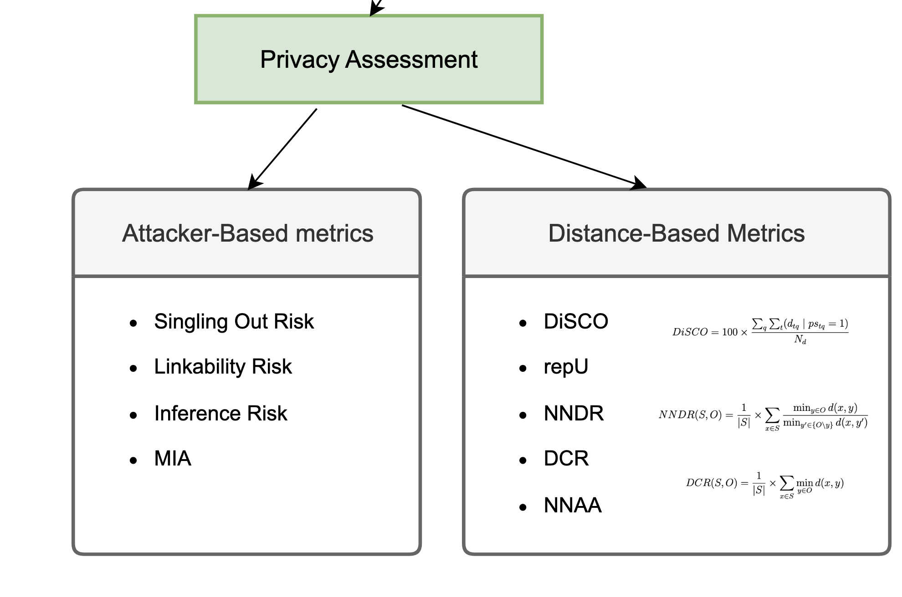
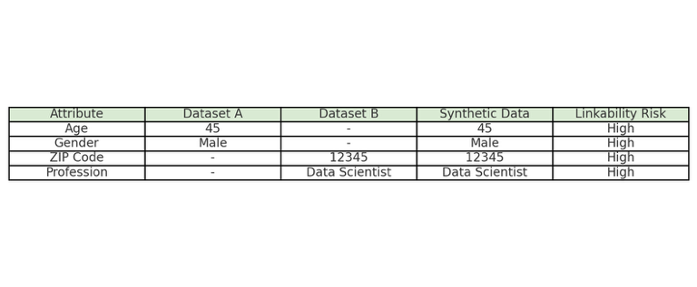
Privacy Metrics
Link together
Notes:
In more detail, for attacker-based privacy metrics, we have chosen the singling out risk, the linkability risk and the inference risk. The membership inference risk has not been implemented due to time-constraints, but it is a metric worth including.
So as an example, the linkability risk refers to the following:
The attacker posesses two datasets A and B,
both of which share some columns with the original dataset that was used to generate the synthetic data.
And then the attacker's aim is to use the information contained in the synthetic data to connect these two datasets, so to find records that belong to the same individual.
For that, the original dataset is split vertically into two parts. Then it is tried to reconnect the two parts using the synthetic data by looking for the closest neighbors of the split original records in the synthetic data.
If both splits of an original record have the same closest synthetic neighbor, they are linked together. The more original records get relinked in this way the more successful the attack.

Slide 9
Privacy Metrics
Notes:
For the distance-based privacy metrics, DiSCO, repU, NNDR, DCR and NNAA were chosen.
For example,
The repU metric measures the risk of identity disclosure by checking how
many unique records from the original dataset are replicated in the synthetic dataset.
((of identity disclosure by evaluating the
replication of unique quasi-identifier combinations in synthetic data))

Slide 10
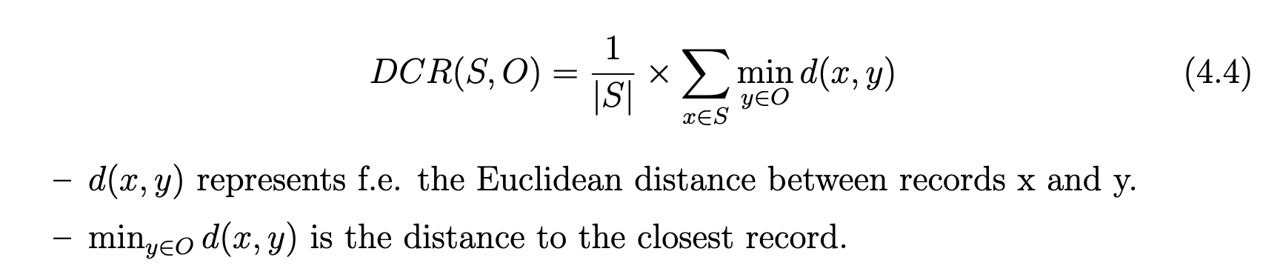
Privacy Metrics
Notes:
And the DCR measures how far apart each synthetic data point is from the nearest data
point in the original dataset, as can be seen in formula 4.4. This metric is used to assess the similarity between
synthetic and original data. A DCR of zero means that the synthetic data point
is identical to the original data point, which could pose a privacy risk.
And of course, higher
DCR values indicate that the synthetic data is more distinct from the original data. The value range of DCR is from 0 to infinity.

Slide 11
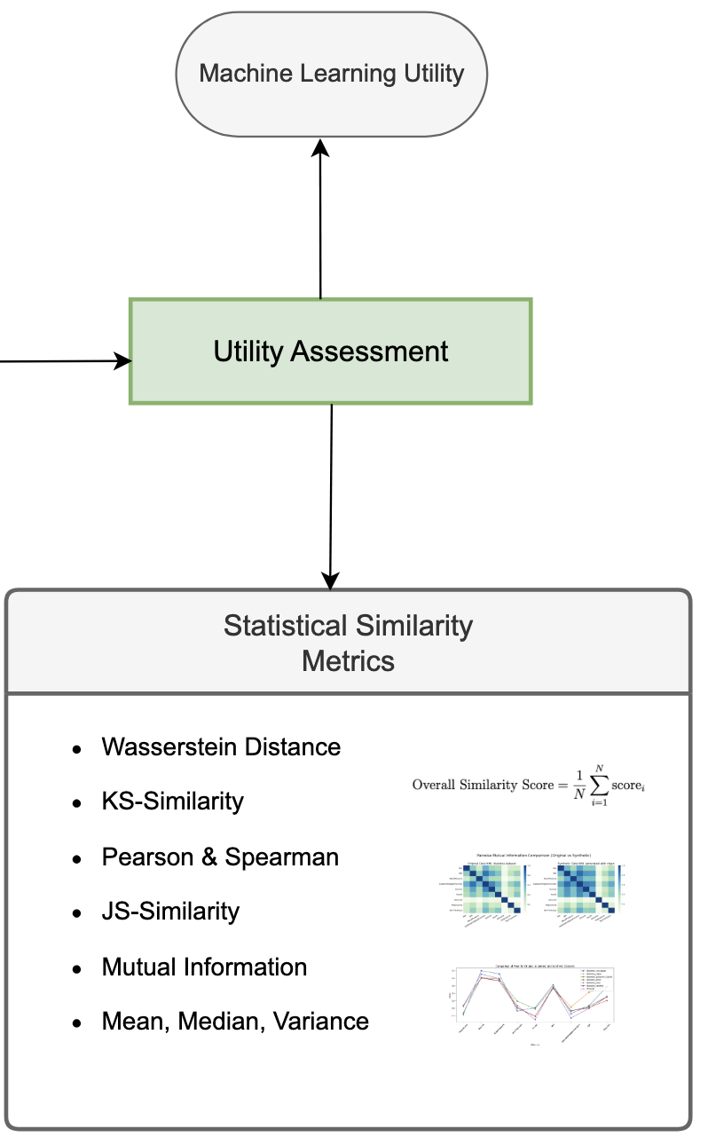
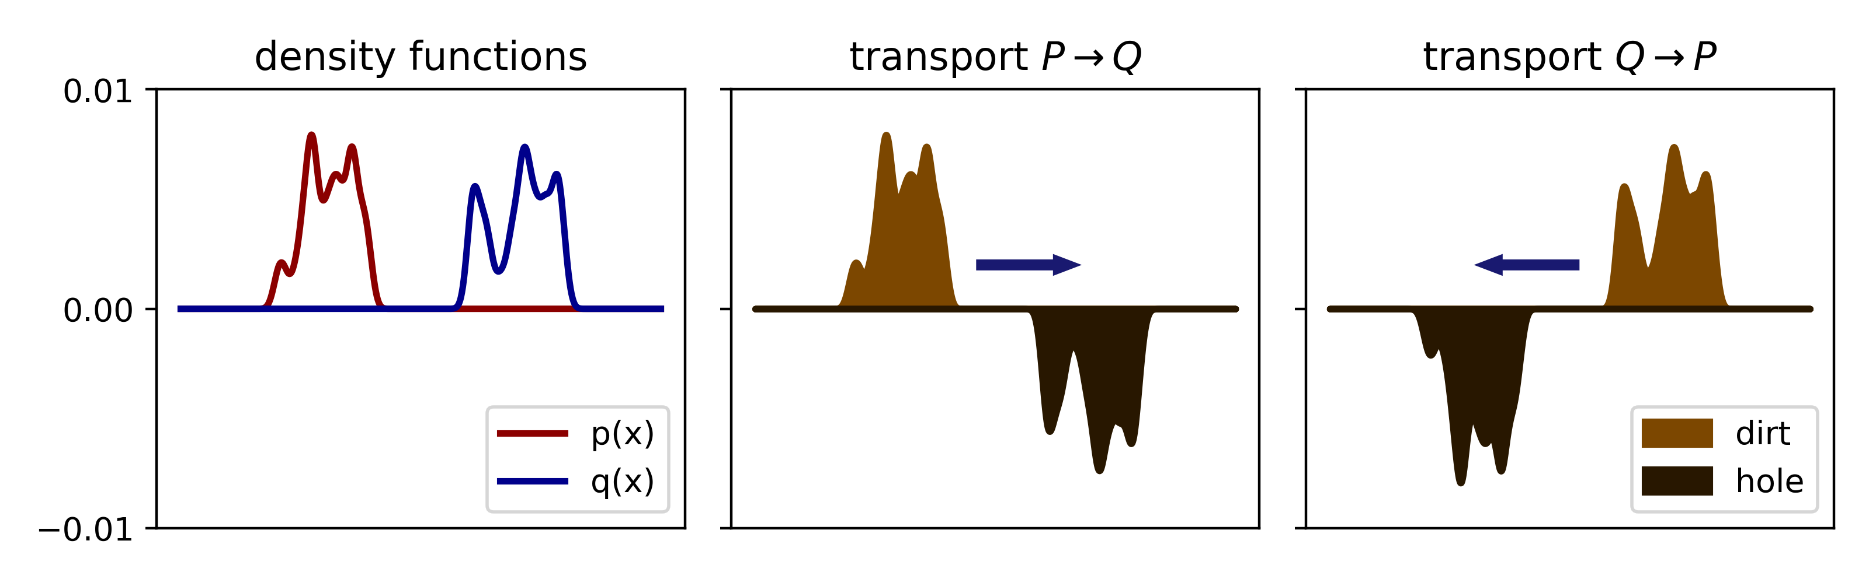
Utility Metrics
Source picture: https://alexhwilliams.info/itsneuronalblog/2020/10/09/optimal-transport/
Notes:
For the utility metrics, we have chosen the Wasserstein distance, the KS-Similarity, the Pearson and Spearman Correlation, the JS-Similarity, mutual information and some basic statistics, such as the mean, median and variance.
For example, the Wasserstein distance, also called earth mover’s distance, which quantifies the cost of transforming one distribution into
another. The distance can range from 0 to infinity and a smaller value indicates that
the two distributions are more similar, while a larger value signifies bigger
differences in the distributions.

Slide 12
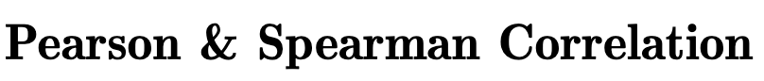
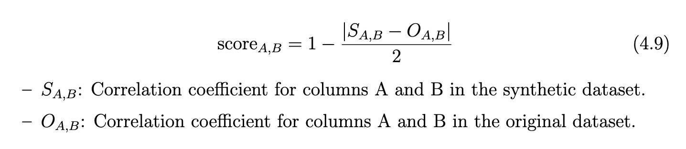
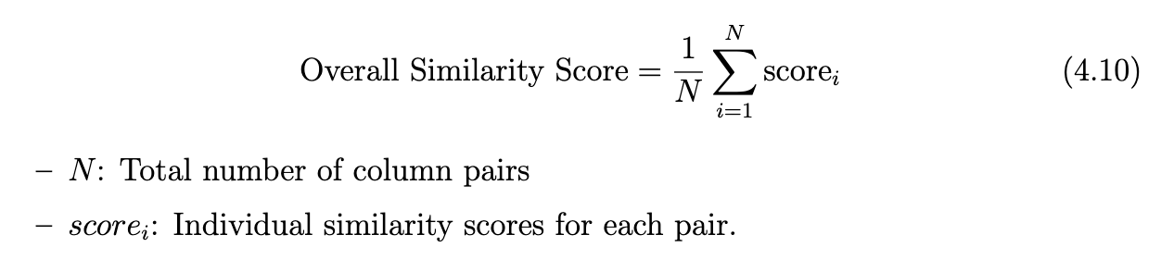
Utility Metrics
Notes:
With the Pearson and Spearman Correlation, it is checked if relationships between variables are preserved.
The correlation coefficients range from -1 to 1, and a value of 1 indicates a perfect positive correlation, -1 indicates a perfect negative correlation, and 0 means no correlation.
For each pair of columns A and B within a dataset, as seen in formula 4.9, the correlation coefficients “Original A,B” and “Synthetic A,B” are calculated. To calculate the individual similarity
Score, we take the difference of those values, divide it by two and subtract it from 1.
For the final score, we take the average of all those values.

Slide 13
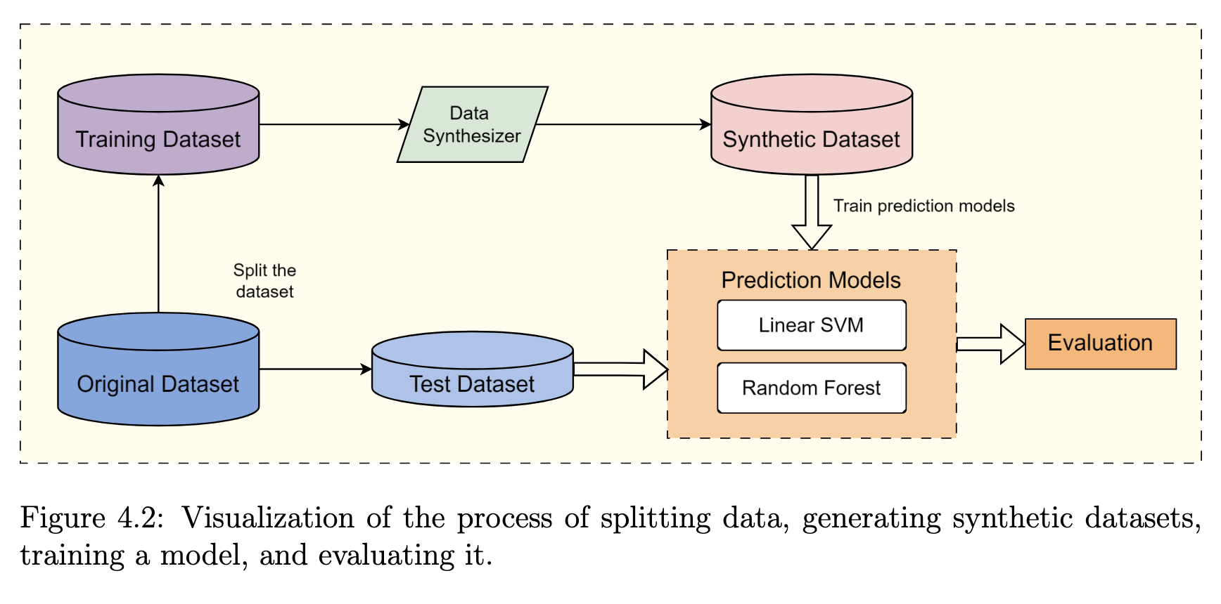
Machine Learning Utility
Notes:
In this thesis, the utility of the synthetic data will be evaluated based on its ability to replicate patterns and relationships found in the original dataset.
One other common approach to measuring utility is by assessing the performance of a machine
learning model trained on the synthetic data compared to one trained on the test set from the original data, and then comparing the results.
A visualization of exactly that process can be seen in figure 4.2.
However, although this method provides important insights into the utility of synthetic data, it will not be explicitly
implemented or tested within the scope of this work.

Slide 14
Implementation
Original data:
pd.Dataframe
or
GaussianCopulaModel
CTGANModel
CopulaGANModel
TVAEModel
GaussianMixtureModel
RandomModel
dynamic_train_test_split
Synthetic data:
pd.Dataframe
Notes:
So for the implementation, we used anaconda to create a virtual environment to properly encapsulate our python code and the packages that we have used for the implementation.
Popular python packages such as pandas, numpy, scipy and sklearn and so on, were used to handle the datasets in our code.
So the user first reads in the data and if desired, can create test-and train datasets out of it which randomly splits the dataset based on its size.
Then, the user is able to create synthetic data with the help of the 6 different synthesizers as seen on the right.

Slide 15
Implementation
MinMaxScaler
OneHotEncoder
Synthetic & Original data:
pd.Dataframe’s
UTILITY METRICS
PRIVACY METRICS
BasicStatsCalculator
CorrelationCalculator
KSCalculator
MICalculator
WassersteinCalculator
JSCalculator
InferenceCalculator
LinkabilityCalculator
SinglingOutCalculator
DisclosureCalculator
AdversarialAccuracyCalculator
DCRCalculator
NNDRCalculator
Notes:
The numerical columns can then be normalized and the categorical columns can be One Hot encoded. For some metrics, it is necessary to encode and normalize the data, for others it is not necessary.
After that, all utility and privacy metrics as seen on the slide can be applied.

Slide 16
Datasets
Dataset | #Rows | #Columns | Column Types | Column Names
Diabetes | 768 | 9 | ints, floats, boolean | Pregnancies, Glucose, BloodPressure, SkinThickness, Insulin, BMI, DiabetesPedigreeFunction, Age, Outcome
Cardio | 70’000 | 12 | ints, floats, boolean, categorical | age, gender, height, weight, ap_hi, ap_lo, cholesterol, gluc, smoke, alco, active, cardio
Insurance | 1’338 | 7 | ints, floats, boolean, categorical | age, sex, bmi, children, smoker, region, charges
Notes:
The first dataset is the diabetes dataset and has 768 rows. That dataset is originally
from the ”National Institute of Diabetes and Digestive and Kidney Diseases” and was
created to predict whether the patient has diabetes based on other measurements in the dataset.
The features of all datasets can be seen in the last column.
((It includes the number of pregnancies the patient has had, glucose, blood pressure, skinthickness and insulin measurements, aswell as the bmi to which degree the patient has diabetes, the age and the outcome column indicates if the patient has diabetes or not.))
The second dataset is the ”Risk Factors for Cardiovascular Heart Disease” and has
70’000 rows. This dataset contains information on risk factors for heart disease.
((and
includes the following columns:
The age, gender, weight and height, some blood pressure cholesterol, and glucose measurements, and if the patient smokes, drinks alcohol and is active. The last column indicates if a cardiovascular disease is present or not.))
For the last dataset that we have chosen to test our framework with, is the “Medical Cost Personal Datasets “and has 1’338 records.
All three datasets have ints, floats, Booleans, but only the cardio and insurance dataset have categorical columns.
(The
following columns, such as age, sex, the bmi, number of children the primary beneficiary has, if the patient is a smoker or not, the residential region and the amount of medical bills issued by the insurance.)

Slide 17
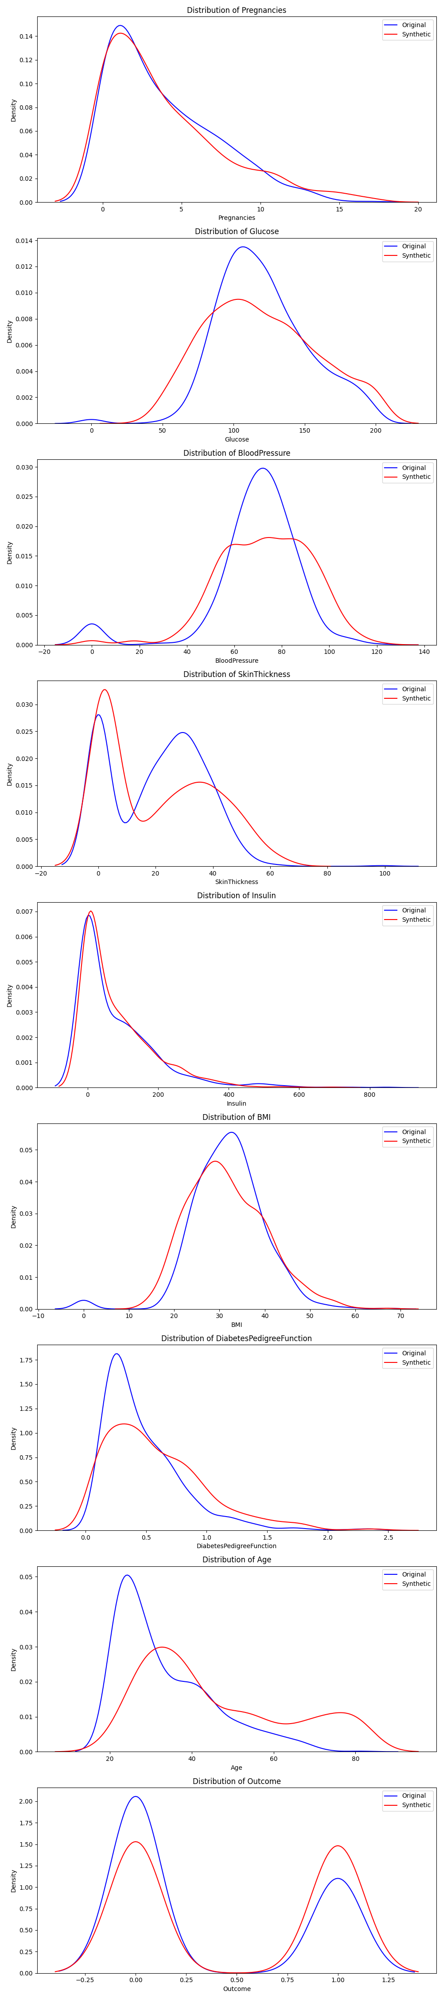
Evaluation: Diabetes Attributes Distribution
Original
Synthetic
Notes:
For the evaluation part, the user is able to create the most intuitive plots to observe the distributions of each attribute of the synthetic data compared to the original data.
In this example, the column distributions of the diabetes dataset are plotted and the blue line corresponds to the original data and the red line to the synthetic data.

Slide 18
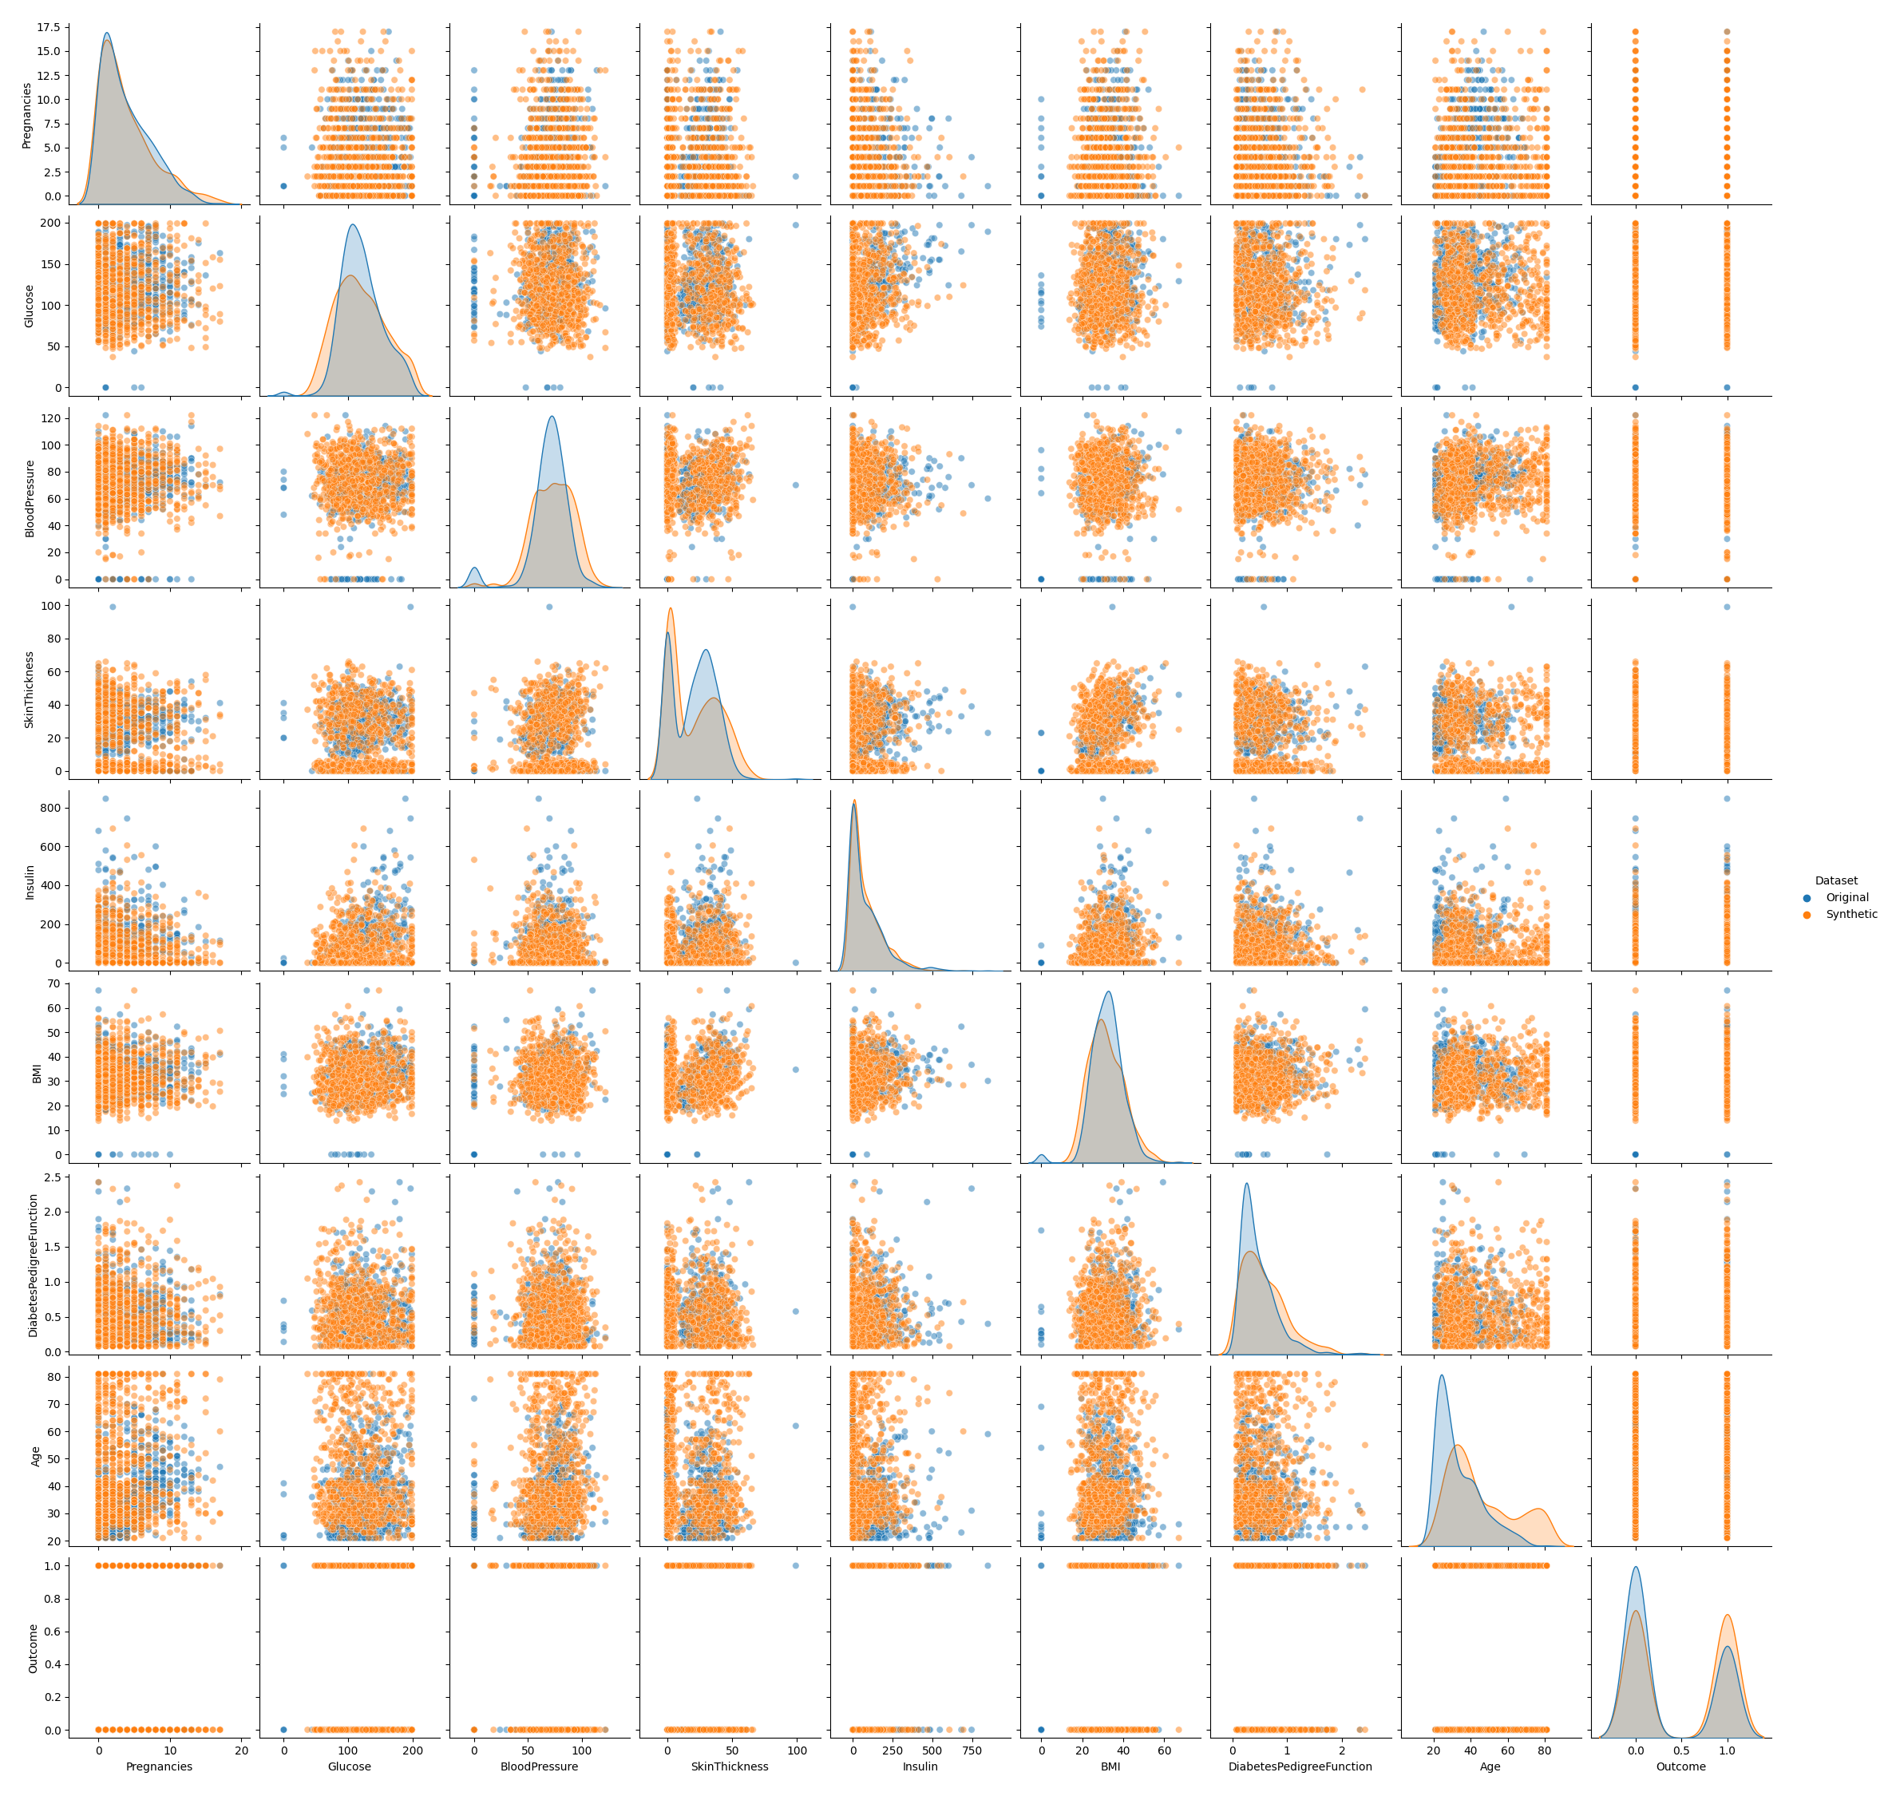
Evaluation: Diabetes Pairwise Attribute Distribution
Original
Synthetic
Notes:
Another possible plot is the pairwise attribute distribution of a dataset, such as the diabetes dataset as seen in this example.
In this plot, the blue lines and dots again correspond to the original data.

Slide 19
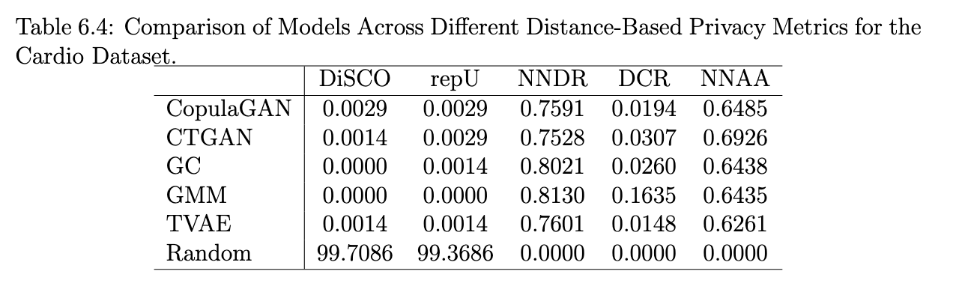
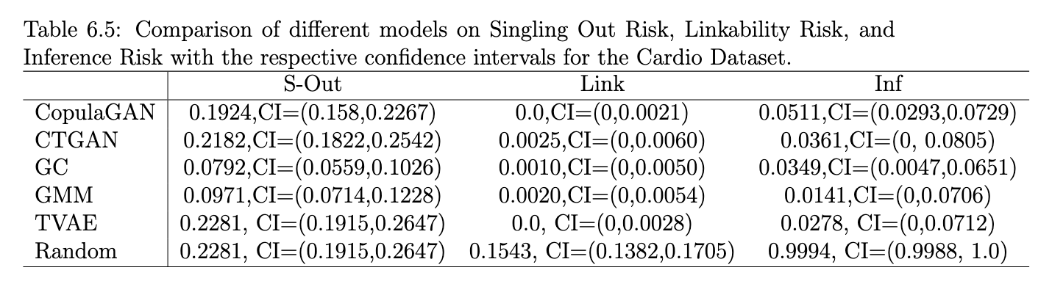
Privacy Metric Evaluation Example: Cardio
Notes:
To have a closer look at the final scores of the privacy metrics, here you can see the two tables we have created for each dataset, but here we have chosen the ones for the cardio dataset.
But in more detail, in the upper table, we can for example look at the DCR column and compare the values of each row with eachother. In this example, the synthetic data generated with the Gaussian Mixture Model
has the highest DCR value for the cardio dataset with 0.1635
which shows us that that synthetic dataset has the biggest distance between the original and synthetic data samples.
And for example in the lower table in the Inference Risk Column, the highest risk comes from the synthetic data generated with the random model, which makes sense because that one simply samples from the original dataset.

Slide 20
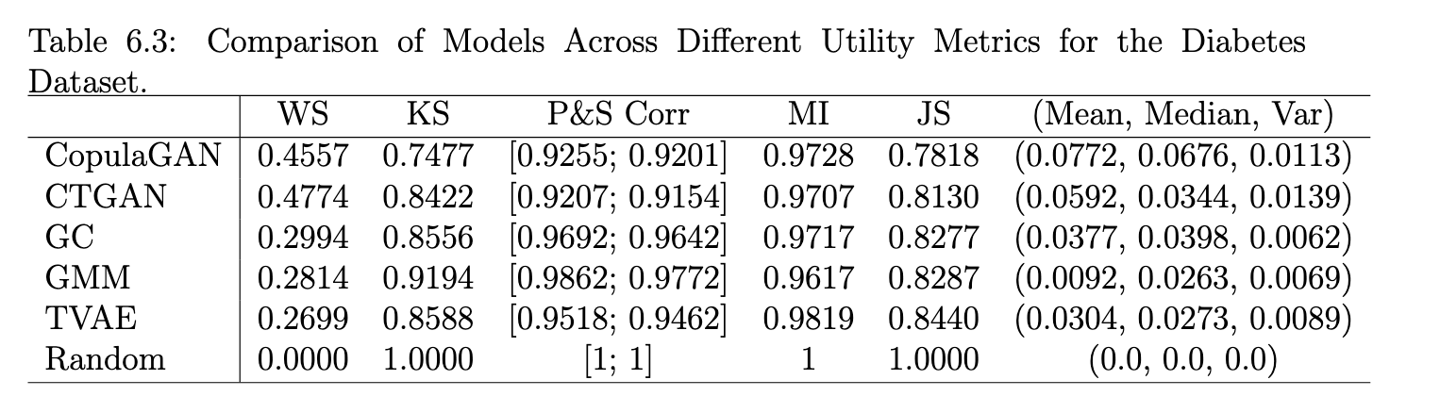
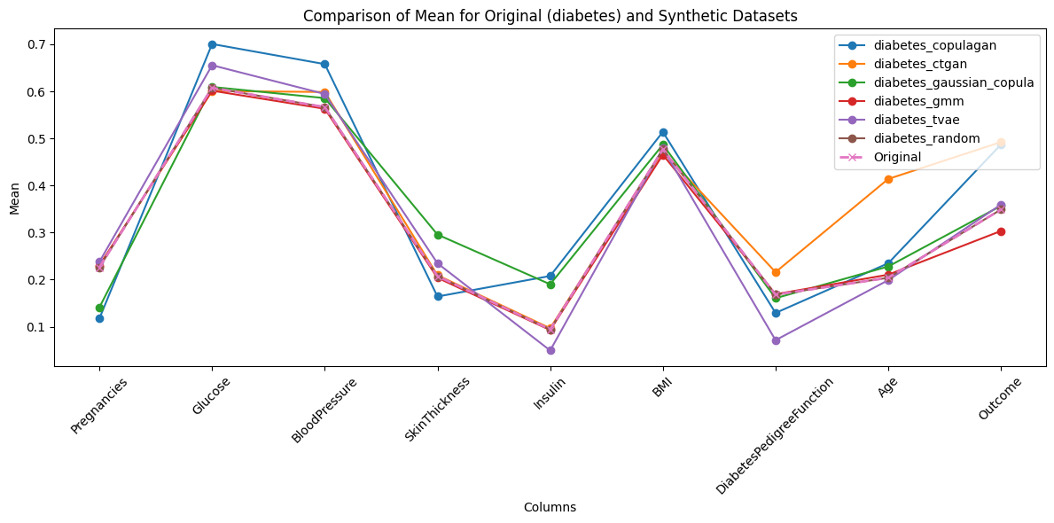
Utility Metric Evaluation Example: Diabetes
Notes:
For the utility scores, we have also created a table for each utility metric.
For example, in here, we can see that the Wasserstein distance is the biggest between the original data and the synthetic data generated with the CTGAN, which indicates that the cost of transforming the original distribution into the synthetic distribution is the highest among all.
And at the bottom, an example plot is given with the plot of each mean for all original dataset columns compared to all other synthetic dataset columns.
There are also other plots that can be created, for the median, variance, the mutual information or the correlations for example, but those plots can all be found in the github repository.

Slide 21
Conclusion
Examined metrics/methods for privacy preservation in synthetic datasets using generative AI.
Categorized and chosen privacy/utility metrics; designed and implemented assessment framework.
Evaluation on 3 healthcare datasets, 6 synthetic data generation models with proposed framework.
Challenges: Results interpretation, balancing utility and privacy; complex to define thresholds and find the best parameters.
Future Work: Further explore/quantify utility and privacy balance; optimize workload-heavy algorithms; evaluate privacy preservation for unstructured data
Notes:
So to quickly summarize everything and conclude this thesis:
The initial phase was about examining different metrics and methods available to assess the level of privacy preservation in synthetic datasets using generative AI.
We then researched, categorized, and chose privacy and utility metrics for final implementation, and designed and implemented the framework.
For evaluation, we picked three healthcare datasets and applied six different models to generate synthetic data.
These synthetic datasets were then evaluated using the implemented privacy and utility metrics. The main challenge is interpreting results—if we look at a column from the results table, it doesn’t necessarily indicate that one model is better than another only based on one metric.
So comparing how models perform across different datasets is complicated and not straightforward. This requires a lot of testing and trying out different approaches, which can be time-consuming and demand a lot of computational power.
So for future work, it is crucial to explore and quantify the balance between utility and privacy, and assess which generative AI models suit specific datasets best. Also,
Optimizing workload-heavy algorithms and evaluating the privacy preservation of unstructured data (e.g., text, images) are important parts that could be worked on in the future.

Slide 22
Thanks for your attention! Any Questions?

